Slide 1
Lecture # 1
Vector Operation

Slide 2
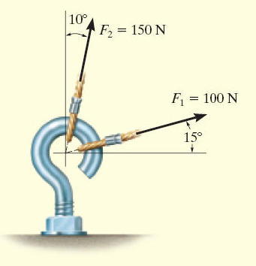
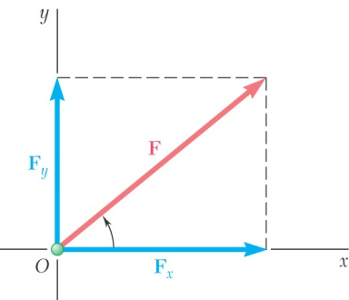
Key Concepts
A little on vectors (and scalars)
Finding Resultant Force (vector addition)
Graphical Approach
Triangle method (or successive triangle method)
Parallelogram method
Finding resultants by resolving forces into components!! (sec 2.4-Addition of a System of Coplanar Forces)

Slide 3
Scalar vs. Vector
Scalar Quantity
A mathematical expression possessing only magnitude characterized by a positive or negative number
The following are classified as Scalar Quantities
Mass
Volume
Length

Slide 4
Scalar vs. Vector
Vector
Physical quantity that requires both a magnitude and a direction for its complete description.
possessing magnitude and direction and must be added using Vector Operations
The following are classified as Vectors
Displacements
Velocities
Accelerations
Moments

Slide 5
SCALARS AND VECTORS
Scalars Vectors
Examples: Mass, Volume Force, Velocity
Characteristics: It has a magnitude It has a magnitude
(positive or negative) and direction
Addition rule: Simple arithmetic Parallelogram law
Special Notation: None Bold font, a line, an
arrow or a “carrot”

Slide 6
Vector Notation
In Slides and handouts Vectors will be denoted as a BOLD letter.
Example;
(a+b) will denote a scalar addition
(A+B) will denote a vector addition
When hand writing a Vector use an arrow over the letter to denote it is a Vector. [ ]
A

Slide 7
Vector Notation
Vector Notation for Rectangular Components of a Vector (e.g Force) can be written in a couple of different ways.
Cartesian Vector Notation – Cartesian unit vectors (i and j) are used to designate the x-axis and y-axis respectively where F=F_{x}i+F_{y}j.
Magnitude and Direction – Define the Vector by magnitude, units, and angle it makes with respect to the x-axis - F= 45N 38°

Slide 8
Vector Operations
Multiplication and Division of a Vector by a Scalar
Product of Vector (A) and Scalar (b) = bA = a vector with the same direction as A but with the magnitude multiplied by the scalar (b).
Example – If a 500 lb force acting along the x-axis is doubled, it becomes a 1000 lb force acting along the x-axis.

Slide 9
Vector Addition
Vectors can be compared to giving directions. Go north 4 steps, Go east 3 steps.
The vector would be defined as the arrow pointing from where you started to where you are now.
The magnitude would be defined by how far are you from where you started (not how far you traveled to get there)

Slide 10
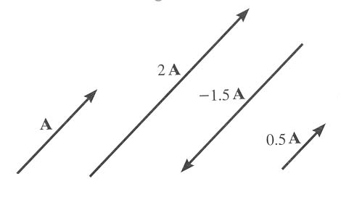
VECTOR OPERATIONS
Scalar Multiplication
and Division

Slide 11
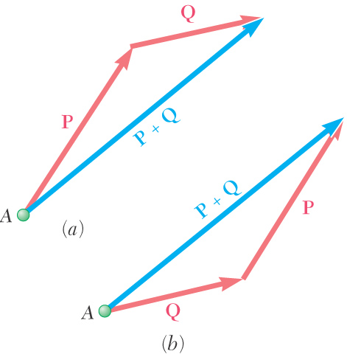
Vector Addition
The addition of two vectors results in a resultant vector (P+Q=R) where R is a vector pointing from the starting point of P to the ending point of Q.
Resultant Vector

Slide 12
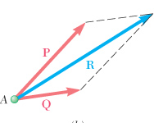
Parallelogram Law
By drawing construction lines parallel to the vectors, the resultant vector goes from the point of origin to the intersection of the construction lines

Slide 13

Triangle Method
Place the tail of B to the head of A. The Resultant (R) can be found by connecting the Tail of A to the Head of B. This forms the third leg of the triangle and the resultant vector.
B
A
A + B
Resultant

Slide 14
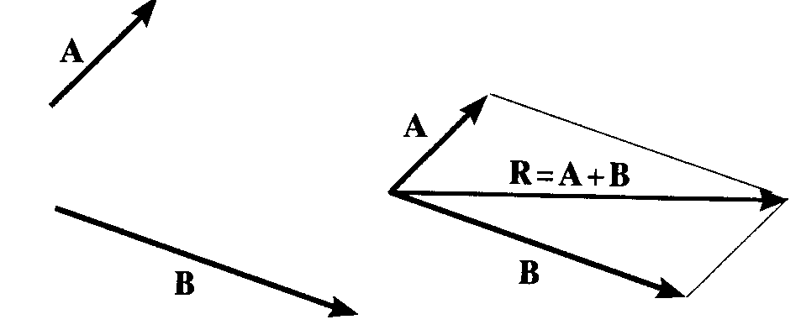
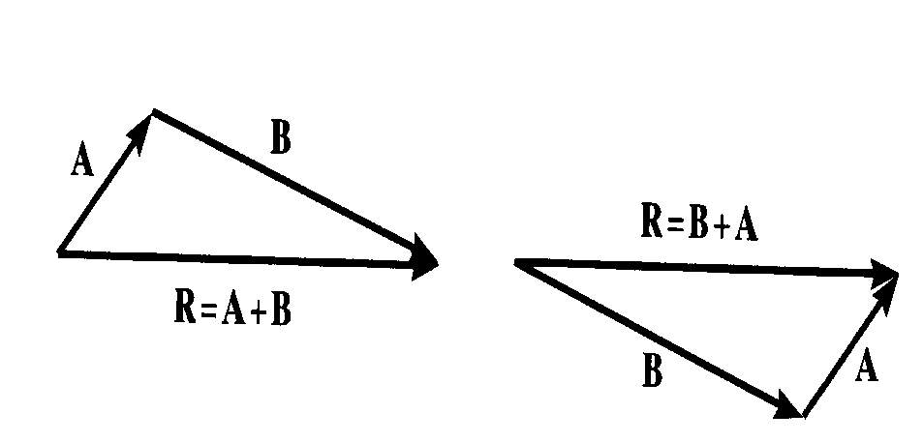
Summary: VECTOR ADDITION USING EITHER THE PARALLELOGRAM LAW OR TRIANGLE
Parallelogram Law:
Triangle method (always ‘tip to tail’):

Slide 15
Example #1
Triangle Method – Find Resultant (mag and direction)
y
30 N
50 N
45°
30°
x

Slide 16
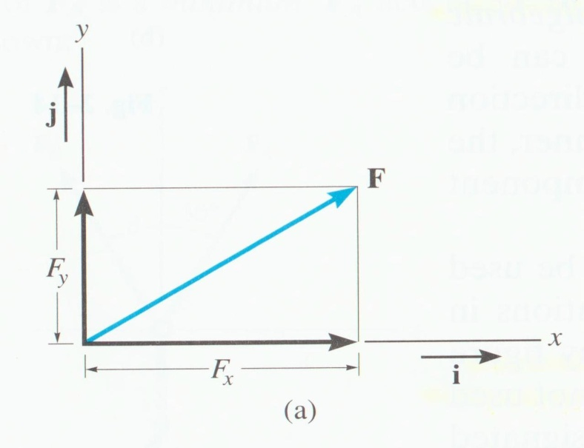
ADDITION OF A SYSTEM OF COPLANAR FORCES (Section 2.4) – Basically finding resultant vectors by breaking forces up into components and adding!
We ‘resolve’ vectors into components using the x and y axis system.
Each component of the vector is shown as a magnitude and a direction.
The directions are based on the x and y axes. We use the “unit vectors” i and j to designate the x and y axes.

Slide 17
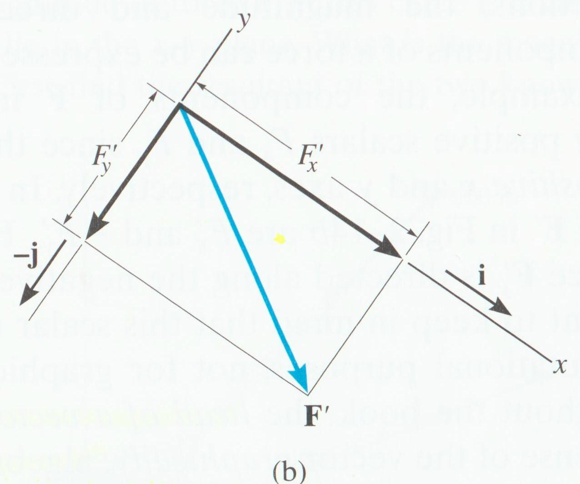
For example,
F = F_{x} i + F_{y} j or F' = F'_{x} i + (− F'_{y} ) j
The x and y axis are always perpendicular to each other. Together, they can be directed at any inclination.

Slide 18
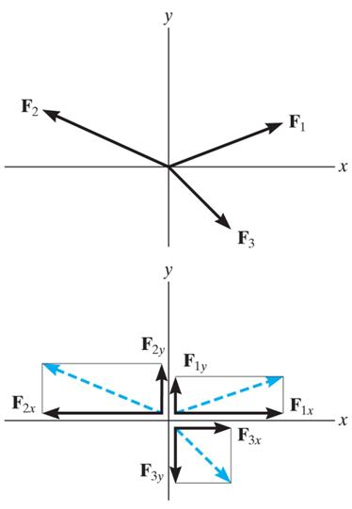
ADDITION OF SEVERAL VECTORS
Step 1 is to resolve each force into its components.
Step 2 is to add all the x-components together, followed by adding all the y components together. These two totals are the x and y components of the resultant vector.
Step 3 is to find the magnitude and angle of the resultant vector.

Slide 19
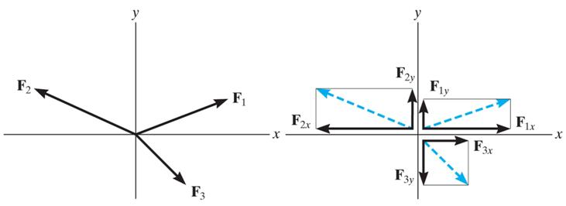
_{An example of the process:}
Break the three vectors into components, then add them.
F_{R} = F₁ + F₂ + F₃
= F_{1x} i + F_{1y} j − F_{2x} i + F_{2y} j + F_{3x} i − F_{3y} j
= (F_{1x} − F_{2x} + F_{3x}) i + (F_{1y} + F_{2y} − F_{3y}) j
= (F_{Rx}) i + (F_{Ry}) j

Slide 20
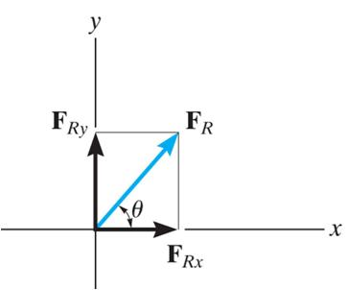
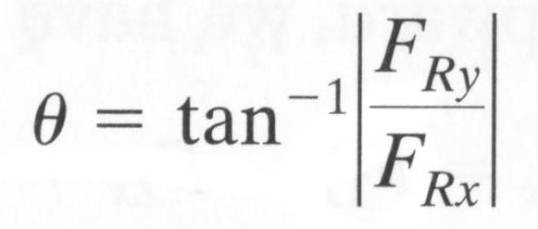
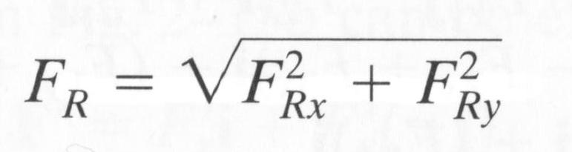
Remember! You can also represent a 2-D vector with a magnitude and angle:
Or, Cartesian Vector Notation:
F_{R} = (F_{Rx}) i + (F_{Ry}) j

Slide 21
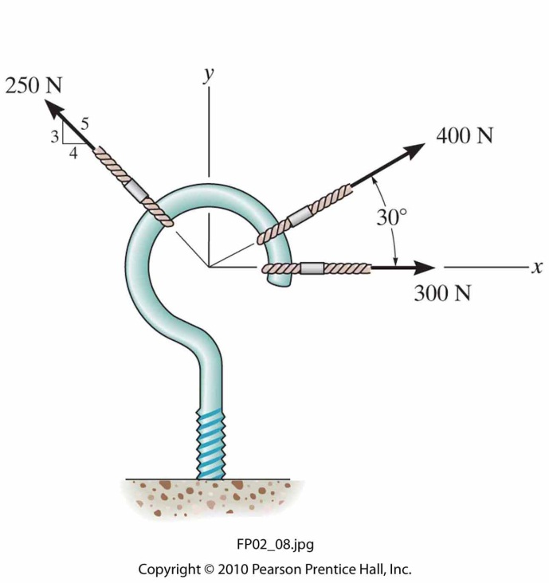
Determine the magnitude and direction of the resultant force.
Side question: What additional force would you have to apply so the net force acting on the hook was zero (think, same magnitude but opposite direction for the resultant force found in step 1).

Slide 22
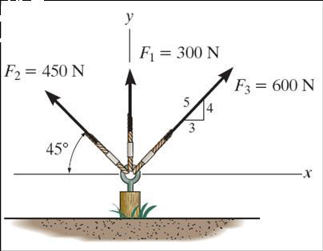
EXAMPLE
Given: Three concurrent forces acting on a tent post.
Find: The magnitude and angle of the resultant force.
Plan:
a) Resolve the forces into their x-y components.
b) Add the respective components to get the resultant vector.
c) Find magnitude and angle from the resultant components.

Slide 23
EXAMPLE (continued)
F₁ = {0 i + 300 j } N
F₂ = {– 450 cos (45°) i + 450 sin (45°) j } N
= {– 318.2 i + 318.2 j } N
F₃ = { (3/5) 600 i + (4/5) 600 j } N
= { 360 i + 480 j } N

Slide 24
EXAMPLE (continued)
Summing up all the i and j components respectively, we get,
F_{R} = { (0 – 318.2 + 360) i + (300 + 318.2 + 480) j } N
= { 41.80 i + 1098 j } N
Using magnitude and direction:
F_{R} = ((41.80)² + (1098)²)^{1/2} = 1099 N
φ = tan⁻¹(1098/41.80) = 87.8°
y
F_{R}
φ
x

Slide 25
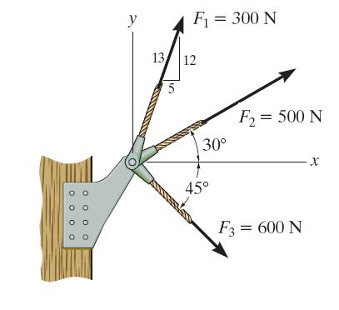
GROUP PROBLEM SOLVING
Given: Three concurrent forces acting on a bracket
Find: The magnitude and angle of the resultant force.
Plan:
a) Resolve the forces into their x and y components.
b) Add the respective components to get the resultant vector.
c) Find magnitude and angle from the resultant components.

Slide 26
GROUP PROBLEM SOLVING (continued)
F₁ = { (5/13) 300 i + (12/13) 300 j } N
= { 115.4 i + 276.9 j } N
F₂ = {500 cos (30°) i + 500 sin (30°) j } N
= { 433.0 i + 250 j } N
F₃ = { 600 cos (45°) i − 600 sin (45°) j } N
{ 424.3 i − 424.3 j } N

Slide 27
GROUP PROBLEM SOLVING (continued)
Summing up all the i and j components respectively, we get,
F_{R} = { (115.4 + 433.0 + 424.3) i + (276.9 + 250 – 424.3) j }N
= { 972.7 i + 102.7 j } N
y
Now find the magnitude and angle,
F_{R} = ((972.7)² + (102.7)²) ^{½} = 978.1 N
= tan^{–1}( 102.7 / 972.7 ) = 6.03°
From Positive x axis, φ = 6.03°
F_{R}
φ
x
Do example on board

Slide 28
ATTENTION QUIZ
1. Resolve F along x and y axes and write it in vector form. F = { ___________ } N
A) 80 cos (30°) i – 80 sin (30°) j
B) 80 sin (30°) i + 80 cos (30°) j
C) 80 sin (30°) i – 80 cos (30°) j
D) 80 cos (30°) i + 80 sin (30°) j
y
x
30°
F = 80 N
2. Determine the magnitude of the resultant (F₁ + F₂) force in N when F₁ = { 10 i + 20 j } N and F₂ = { 20 i + 20 j } N .
A) 30 N B) 40 N C) 50 N
D) 60 N E) 70 N
Notes:
Answers:
1. C
2. C

Slide 29
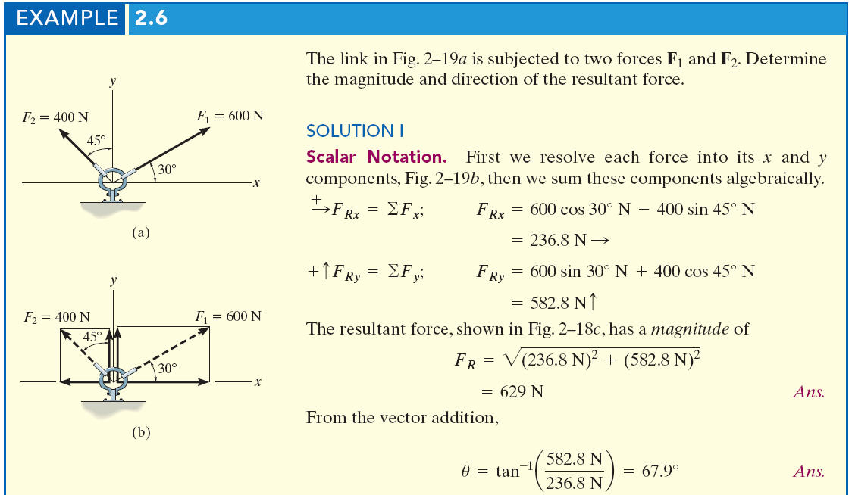
Notes:
29

Slide 30
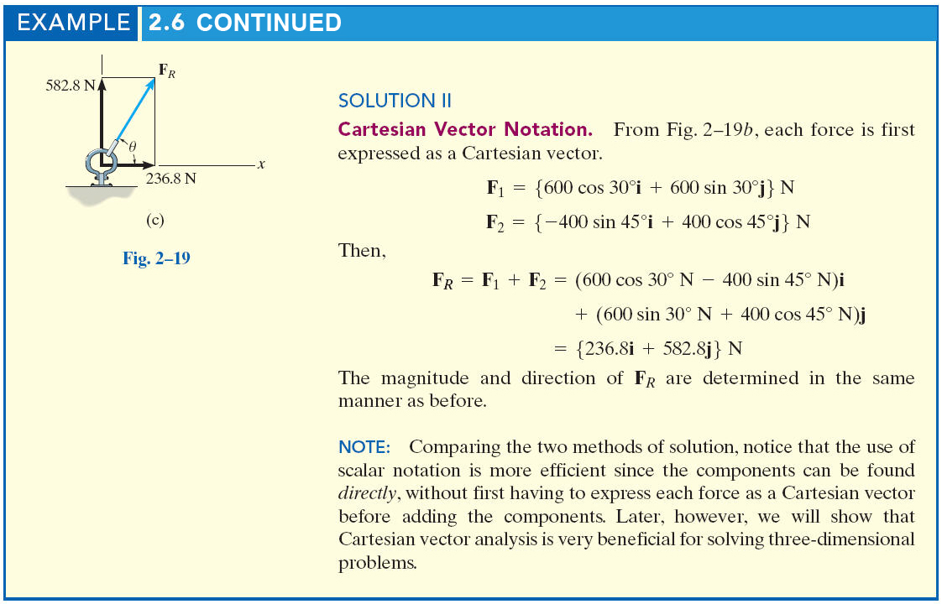
Notes:
30

